Slide 1
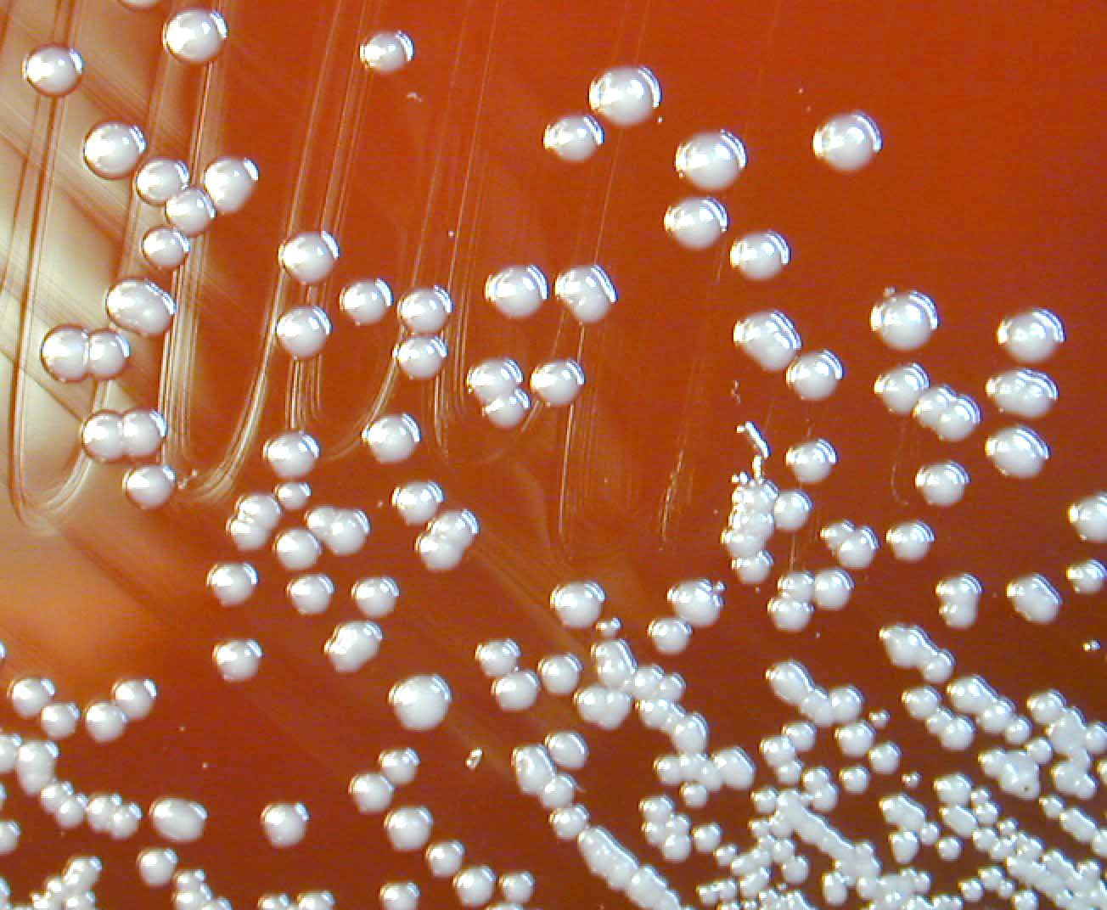
Genus Burkholderia
Is an environmental organism that can grow in water, soil, plants, animals & decaying materials. It include more than 30 species, of which only B. mallei & B. pseudomallei are animal pathogens.
Because B. Mallei can be transmitted by aerosol, it has been used as a bioweapons by many programs. Both bacteria are so extraordinary dangerous in a laboratory settings, biosafty level 3 precautions should be followed.
On Gram’s stained smear, B.mallei from young culture produce long slender rods with rounded ends & often stained irregularly. Older culture may be pleomorphic (coccobacilli to long filaments). B.psudomallei culture revealed small G- rods with bipolar staining that resembling safty pins. Both bacteria are oxidase positive & can grow on MacConkey agar. B.pseudomallei can grow at 42 C & motile.

Slide 2
Disease & epidemiology B. mallei
B. Mallei is the etiological agent of glanders, a serious contagious disease of equine. The organism is a true parasite because it is unable to survive in nature for extended period in the absence of its host. Bacteria are unable to remain viable in the environment for more than 2 weeks, & can be readily killed by most commonly used disinfectants. Carnivores may develop acute septicemia by consume meat from infected animals. Occasionally natural infection have been reported in sheep, goat, & camels, but swine & cattle are resistant to infection.
Glanders is widespread throughout the world, but it is eradicated in USA & Western Europe. Pockets of active disease still exist in North Africa, China, Middle East, India, SE Europe, Central & South America.

Slide 3
Disease & epidemiology B. mallei
Disease introduced into equine by infected animals. Ingestion of B. mallei which is present in high numbers in secretion of infected animal, is the most common route of infection. Skin invasion & inhalation are minor routes of transmission.
Glanders may be acute or chronic. Acute infection is more common in mules & donkeys. These animals have high fever & respiratory signs, including swollen nostril, dyspnea & pneumonia. Death occurs within few days.
Glanders usually manifest as a chronic infection in horses, & infected animal may survive for several years. Disease occurs in nasal, cutaneous (Farcy) & pulmonary forms. The prognosis of infected animals is poor, & those that recover are not immune to reinfection. These animals remain latently infected & serve as a source of infection for other animals & human.

Slide 4
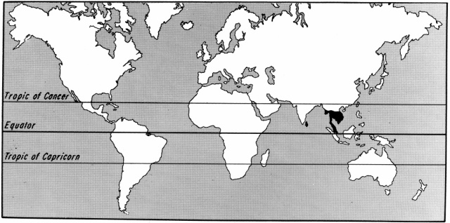
Disease & epidemiology B. mallei
Glanders is zoonotic, & is transmitted to humans by direct contact with sick animals or infectious materials or through ingestion of glandered meat. Veterinarians, farmers, abattoir workers are at increased risk for infection. Cases of human-to human transmission have been reported. Human disease can manifest as acute localized infection, septicemia, acute respiratory infection or chronic cutanous infection.
Symptoms include fever, headache, myalgia, lymphadenopathy, malaise, chest pain splenomegaly & pastular skin infection.

Slide 5
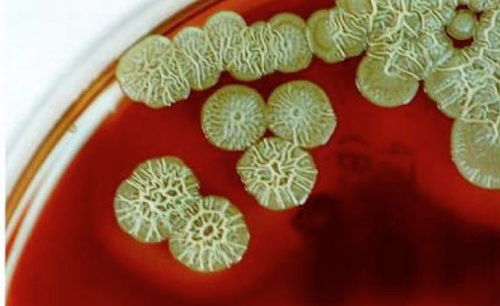
Disease & epidemiology B. pseudomallei
Is the cause of melioidosis or pseudoglanders, a highly fatal disease of humans & other mammals. The organism is a saprophyte, ubiquitous in soil & surface water. Melioidosis has been diagnosed in all domestic animal species (horses, sheep, goats, cattle, pigs, dogs, cats). Rodents acts as a source of infection in endemic tropical & subtropical regions. Increased disease incidence often associated with heavy rainfall. Humans & animals acquired infection by ingestion of contaminated water, inhalation of dust & contact with contaminated soil, especially through skin abrasions or wounds. Several cases have been attributed to arthropod bite. Zoonotic transmission has not been documented.

Slide 6
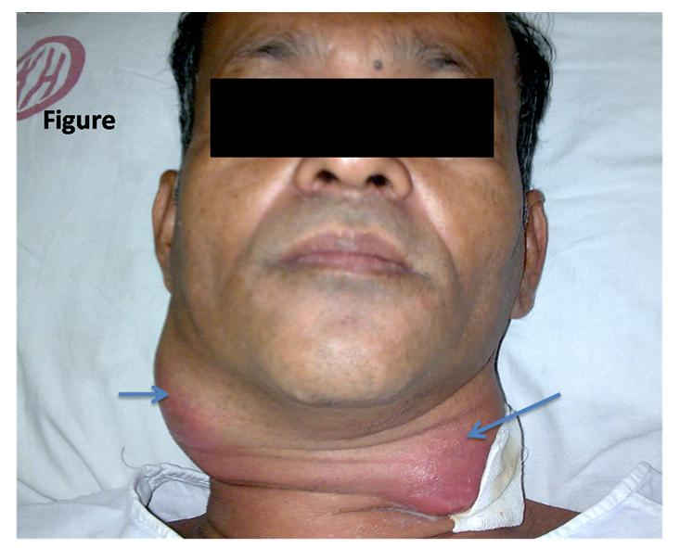
Disease & epidemiology B. pseudomallei
Animal infections with B.psudomallei are usually systemic . Melioidosis causes a chronic nodular or purulent inflammatory disease. Nodular lesions may form in any tissue & suppurate. Acute disease with terminal sepsis may occur. Small caseous cutaneous nodules rapture, releasing more organisms into environment or infecting other animals. Outbreaks of melioidosis have been reported in ruminants & pigs. Arthritis & pneumonia are common clinical findings.
Human melioidosis is also called Whitmore’s disease, ranging from asymptomatic to severe sepsis with rapid fatality. Disease may also present as pneumonitis, acute, subacute or chronic pneumonia, or an acute, subacute or chronic suppuration.

Slide 7
Pathogenesis of glanders
After infection B.mallei penetrate the intestinal or pharyngeal mucosa & enters the regional lymphatic vessels & then to the blood, & disseminate to all parts of the body, but colonizes only the lymphatics of the RT & skin. nodules may develop in the lymph channels which eventually ulcerate to discharge their exudate containing large numbers of bacteria. Primary nodular lesions at the point of entry in the nasal passages & pharynx also ulcerate & discharge yellow infectious exudate through the nostrils. Polysaccharide capsule is essential for virulence of B.mallei. Toxins disrupting host cellular functions include pyocyanin which interferes with terminal electron transfer. Lecithinase, collagenase & lipase mediate cell lysis through membrane lysis.

Slide 8
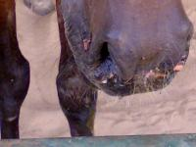
Pathogenesis of melioidosis
After phagocytosis, B. pseudomallei escape the endocystic vacuoles & form membrane protrusion that mediate cell-to-cell transmission followed by tissue localization & LN, spleen, liver lungs & joints are usually affected. Depending on the infectious dose the disease may be cute or chronic.
The role of extracellular enzymes e.g. lecithinase, lipase & dermonecrotic protease is unknown. Heat-labile components are responsible for cytotoxic & anticoagulent activity. Malleobacterium is a sidophore that is evolved in iron acquisition . Evasion of complement mediated killing is probably the key virulence determinant of B. pseudomallei. Flagella & pilli are virulence factors. The polysaccharide capsule protect against antibiotic penetration. B. pseudomallei are intracellular pathogen & this explain the poor response to antimicrobials.

Slide 9
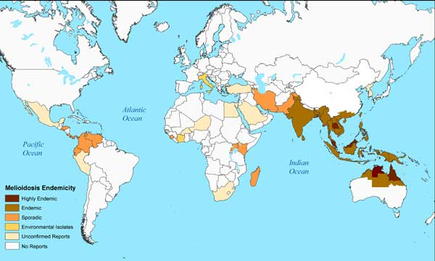
Epidemiology of melioidosis

Slide 10
Laboratory diagnosis
Glanders & melioidosis may be definitively diagnosed through the isolation & identification of the causative agents from the blood or tissues.
B.Mallei grow well on routine laboratory media, e.g. 5% sheep blood agar, MacConkey agar & chocolate agar. It s growth can be enhanced by addition of 1% glycerol to agar media.
B.Psudomallei grow more rapidly on ordinary media.
Selective media facilitate the isolation of B.mallei & B. pseudomallei from specimens with mixed flora. Selective media for isolation of B.mallei contain Bacitracin, Polymixin B & actidion. Ashdown’s medium for the isolation of B.pseudomallei contain gentamycin & crystal violet as inhibitory substances.
Colonial morphology is a useful feature for identification of these agents.
Morphology in Gram’s stained smear differentiate between these two species.
Serology is useful for the diagnosis of both glanders & melioidosis. Antibodies can be detected by complement fixation, ELISA & indirect hemagglutination.
Fluorescent antibody assays or molecular by PCR & immunohistochemistry.

